Slide 1

COLLEGE CLUB WEBSITE
BY: TECHIE TERRABYTES

Slide 2
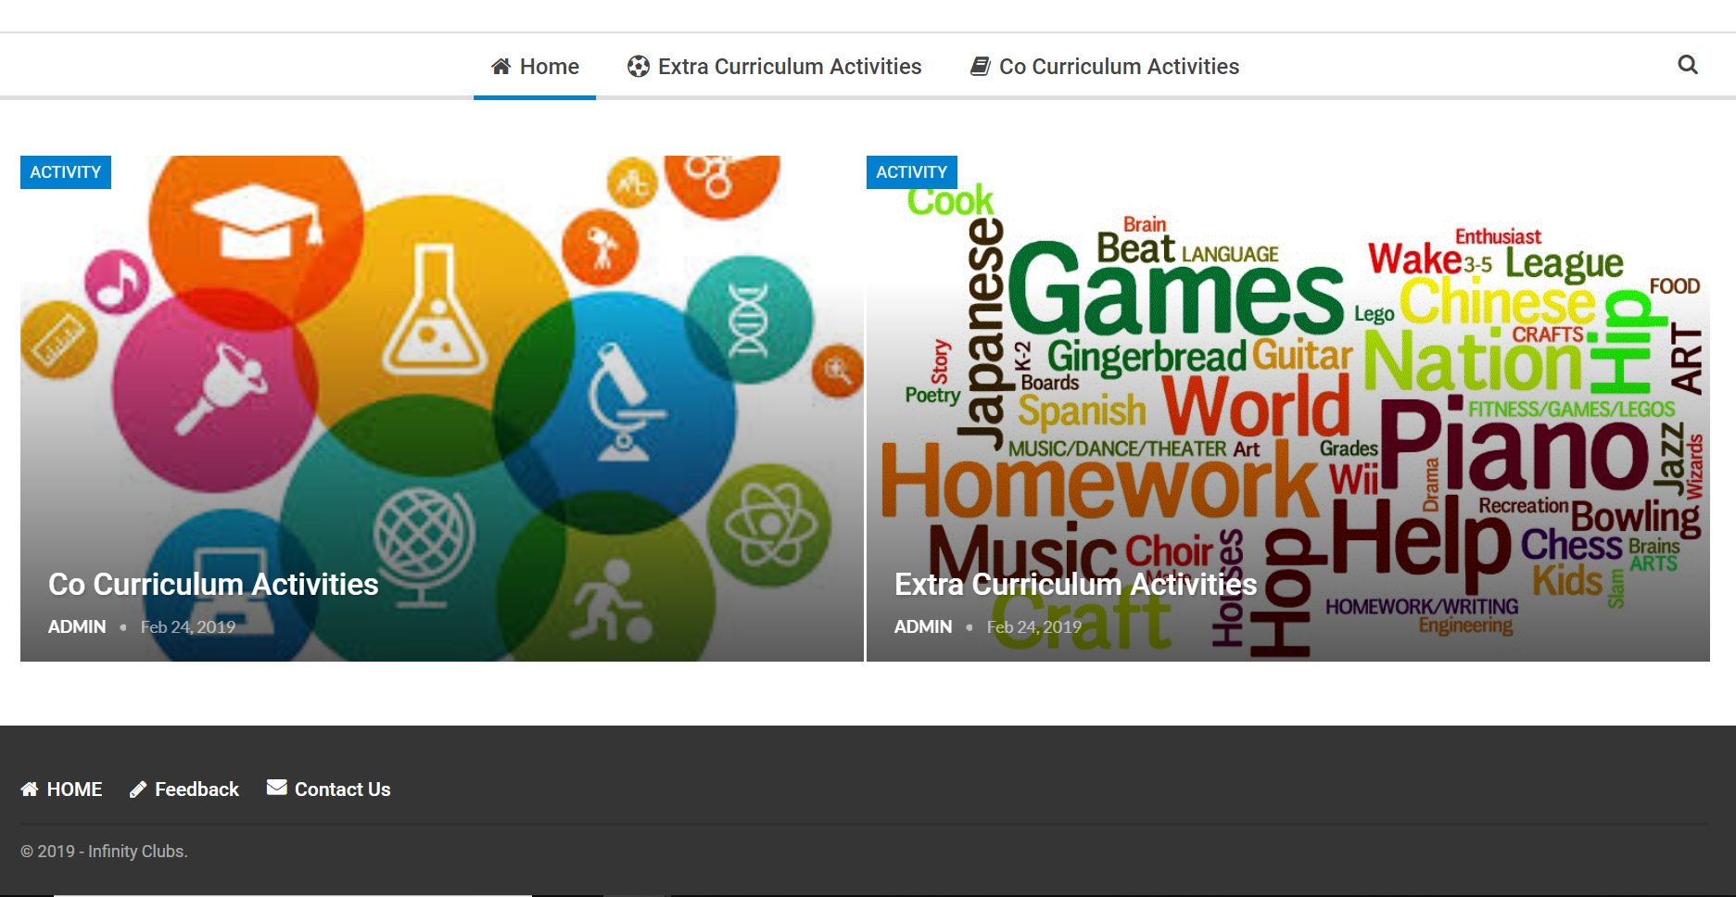
Our Site:http://www.collegeclubs.tk/

Slide 3
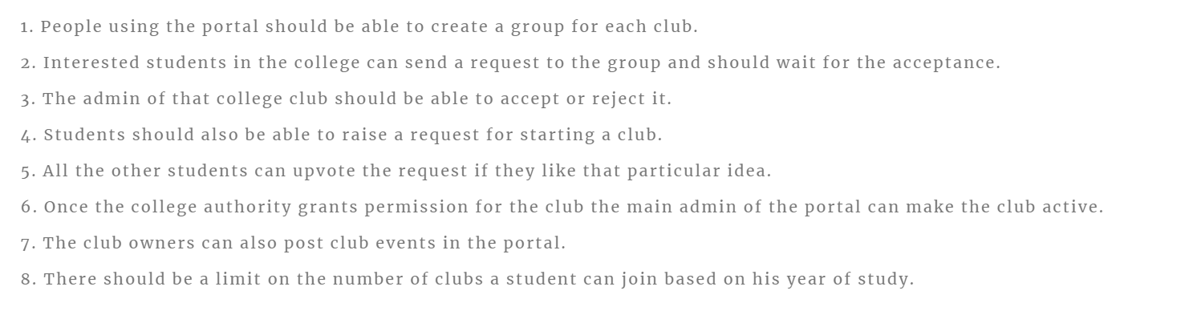
FUNCTIONAL REQUIREMENTS:

Slide 4
WEBSITE PURPOSE:
THE PURPOSE OF THIS MINI-SITE IS TO DEVELOP A VALUABLE SET OF
INFORMATION SOURCE THAT PROVIDES THE STUDENTS ABOUT INFORMATION AND NEWS ABOUT THE CLUBS IN THE COLLEGE.
THIS WEBSITE WILL ALSO SERVE AS A LOCAL SOCIAL ENVIRONMENT THAT ALLOWS FOR CLUBS TO DISCUSS AND CHAT ABOUT CLUBS RELATED TOPICS

Slide 5
TARGET AUDIENCE:
COLLEGE STUDENTS (OF ANY YEAR) …………
PEOPLE WANT TO SHOWCASE THEIR SKILLS IN THESE PLATFORM
OPEN SOURCE:
UNLIKE A PROPRIETARY PAID-FOR SYSTEM,WORDPRESS IS A COMPLETELY OPEN SOURCE
UNDER AN EXTREMELY PERMISSIVE MIT LICENCE.

Slide 6
STRUCTURE AND DESIGN:
THE MAIN HOME SCREEN CONSISTS OF TWO CATEGORIES WHICH ARE C0-CURRICULAR AND EXTRA-
CURRICULAR WHICH WILL NAVIGATE THE USER TO THE CLUBS WHICH HE IS INTERESTED IN.WE GAVE THE REG-
-STRATION FOR THE CLUB THEN AND THERE ITSELF FOR THE USER CONVENIENCE.

Slide 7
SOCIAL MEDIA APPROACH :
OUR BACKBONE OF SOCIAL STRATEGY IS TO INTERACT WITH OUR TARGET AUDIENCE AS A SOCIABLE BRAND BY BUILDING AN ONLINE COMM
UNITY HUB THROUGH WHICH COLLEGE AND AUTHORITY IN THE CLUB INCHARGES CAN DELIVER ENGAGING CONTENT AND ACTIVITIES GENERATE BUZZ LEADING UP TO THE EVENT. IT IS
SUPPORTED THROUGH OTHER DIGITAL PLATFORMS.

Slide 8
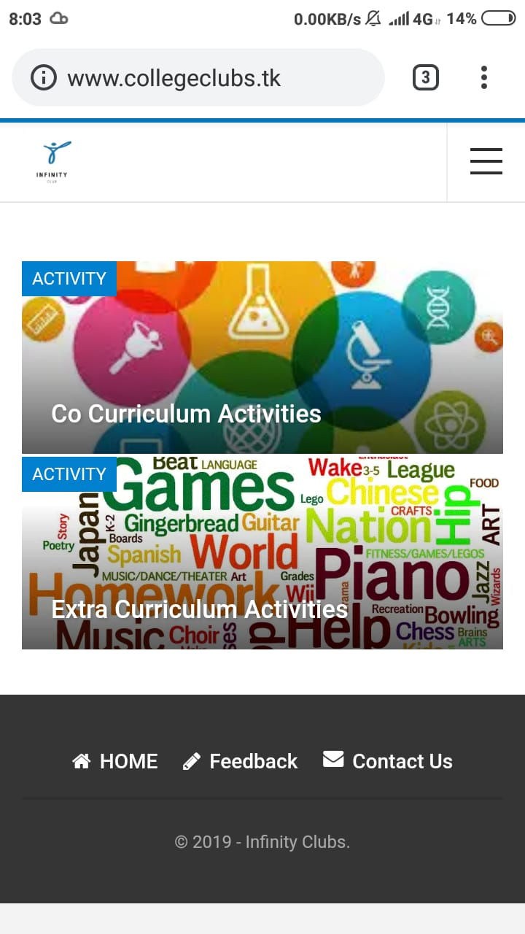
contents:
Our site fulfills all the requirements needed by a college club
It contains both curricular and extracurricular activities.
The student can choose the activities he /she is interested and can register into it.
Admin has the right to accept and reject the request of the student.
The admin can send notifications can be reached to the students if there is an event nearby.
A feedback form is available for the students to give their opinions and suggestions.

Slide 9
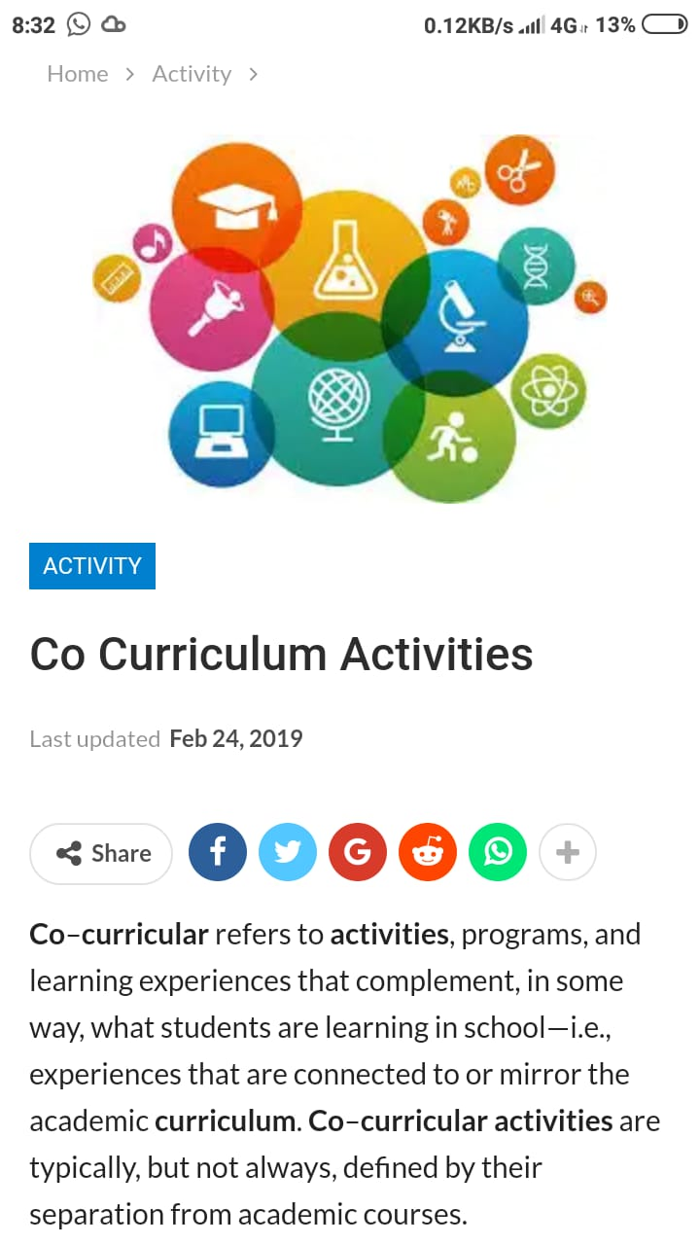
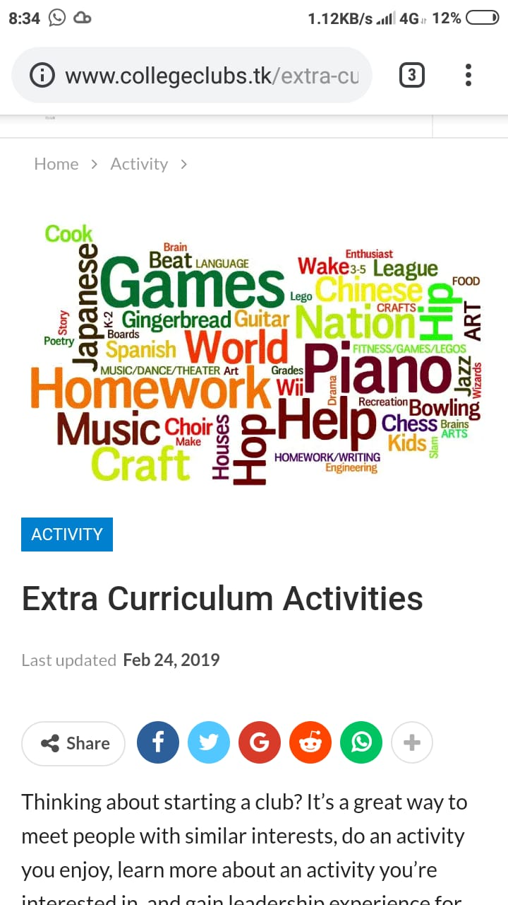
ACTIVITIES:
“IT IS A PLATFORM TO ENCOURAGE THE STUDENT TO EXCELL IN BOTH HOBBIES AND PASSION”
HERE WE PROVIDE COMMUNITIES WHICH HAVE SIMILAR INTEREST TO INTRACT AND LEARN NEW STUFF FROM EACH OTHER EVERY DAY

Slide 10
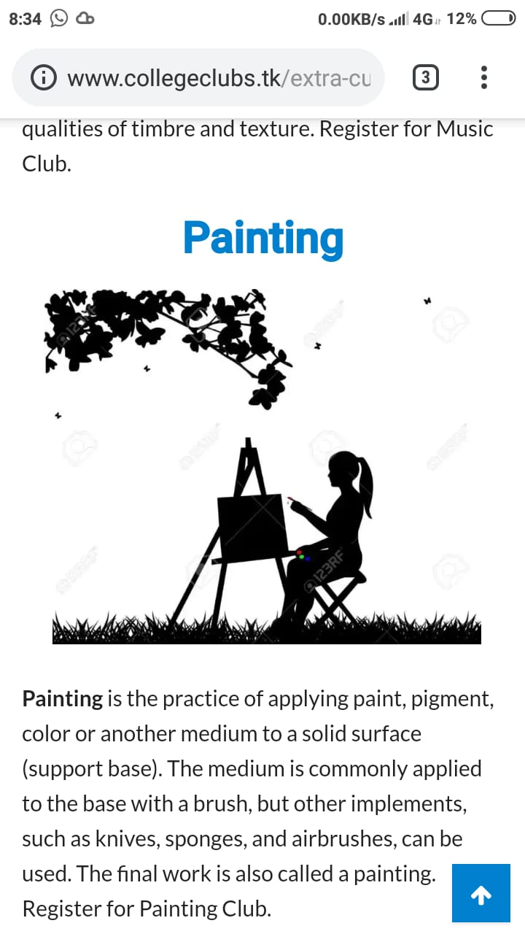
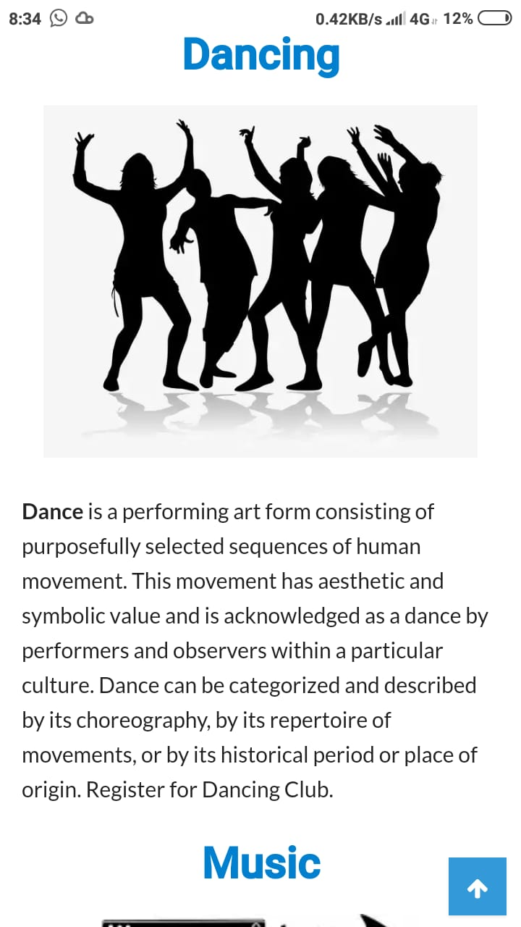
HERE WE HAVE ACTIVITIES WHICH ARE BOTH GOOD FOR THE MIND AND BODY

Slide 11
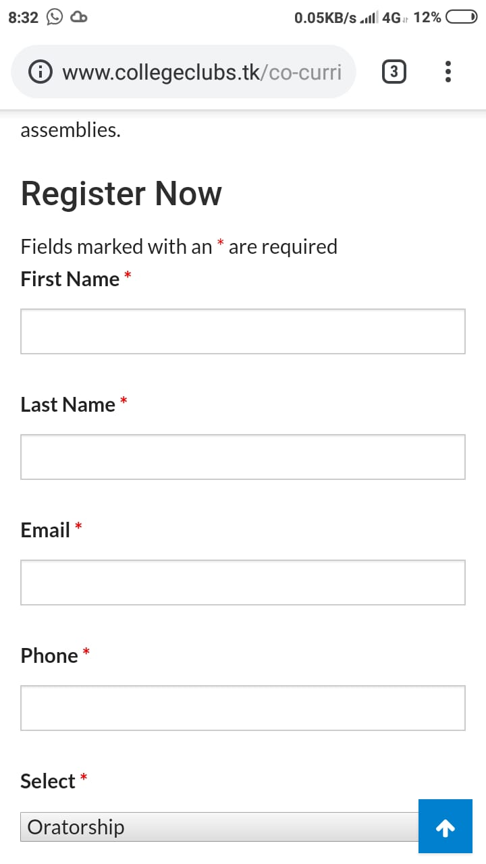
STUDENT HAS THE FREEDOM TO CHOOSE AND REGISTER INTO HIS/HER FAVORITE CLUB.

Slide 12
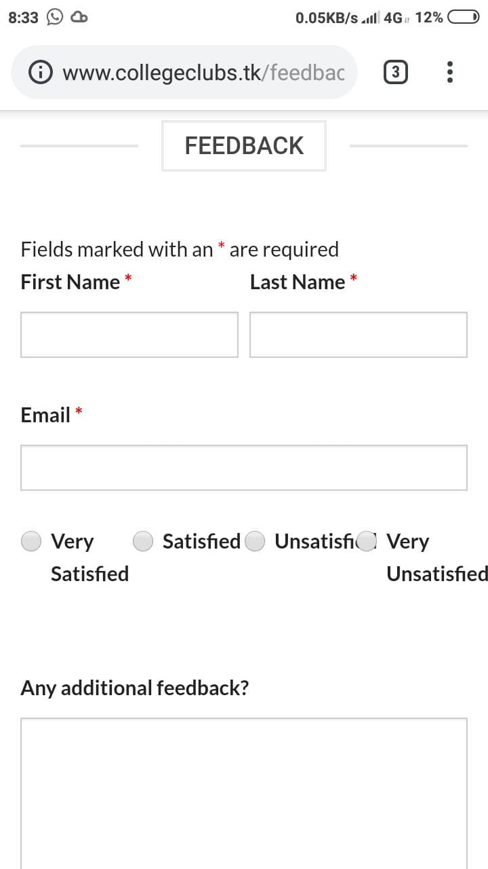
A FEEDBACK FORM
IS PROVIDED TO THE STUDENTS TO CONVEY THE SATISFACTORY LEVEL ,OPINIONS AND SUGGESTIONS

Slide 13


FRONTEND:
WE USED WORDPRESS
CSS HTML TO CREATE LAYOUTS AND BUTTONS IN OUR WEBSITE.

Slide 14
BACKEND:
WE USED PHP AND JAVASCRIPT CODES TO SUPPORT THE WEBSITE.
MYSQL IS USED TO MANAGE THE DATABASE WHICH STORES ALL THE DETAILS ABOUT THE STUDENTS.

Slide 15
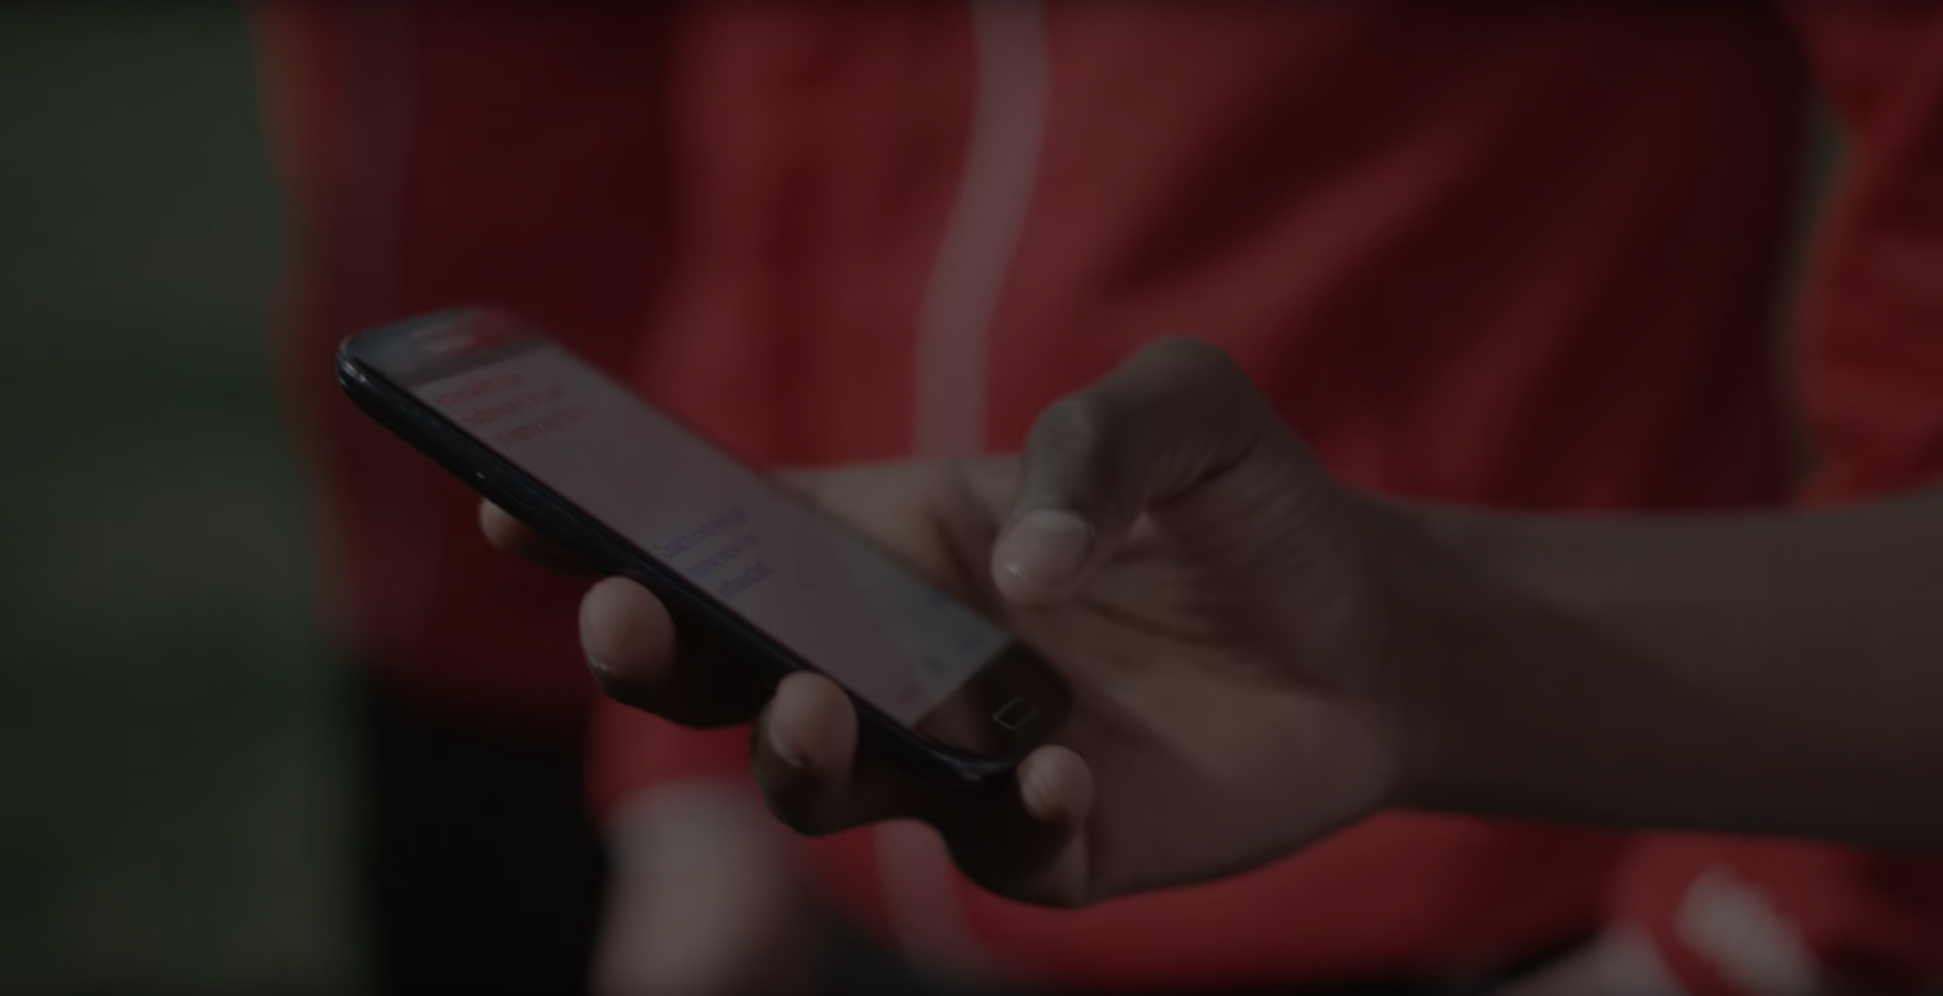
THANK
YOU

